Slide 1
LTE Projects
November 1, 2010

Slide 2
LTE Summary
Long Term Evolution (LTE) is the next major step in mobile radio communications, and will be introduced in 3rd Generation Partnership Project (3GPP). The aim of this 3GPP project is to improve the Universal Mobile Telecommunications System (UMTS) mobile phone standard and provide an enhanced user experience and simplified technology for next generation mobile broadband. LTE enables fixed-to-mobile migrations of Internet applications such as Voice over IP (VoIP), video streaming, music downloading , mobile TV and many others.
AT&T plans to introduce LTE into its existing mobility network in two phases. Phase 1 will provide support for data only services. Phase 2 will incorporate the support of voice services. The LTE infrastructure involves 3 primary areas within network: Radio Access Network (RAN), Universal Core/IMS (UIC), and the evolved packet core (EPC).
Total of 26 LTE projects
3 VPMOs

Slide 3
LTE Status
Project Number | TSR | Description | Release | ETE (Y/N) | Test Dates | Comments | Timeline
202193 | 3928 | LTE – Session Based Speed Tiers | 1010 | N | 9/20 – 10/8 | ETE testing will be performed in Post 1010. Retail Functional apps will perform testing in K201996 Regression testing of Functional TLG Switch Control, Horizon Agent/COR in progress. 80 test cases (0 % passed / completed) | Deployment 10/18 Launch/Utilization 10/25 (Controlled Introduction)
201996 | 3824 | LTE – Speed Tiers | 1010 | N | 10/2-12/1 | ETE testing will be performed in Post 1010. Retail functional testing in progress. Functional pass 1-1795 test cases (100% passed / completed) pass 3-414 test cases (100% passed/completed) pass 4-72 test cases (13.16% passed / completed) IST pass1 -21 test cases (100% passed/completed) pass2-21 test cases (100% passed/completed) | UAT online testing start 9/27
201997a | 3568 | LTE – Real Time Notification | 1010 | N | 8/23-10/18 | ETE testing effort will be post 1010 since it is dependent on PCRF policy updates needed to test K201996. Functional testing (Atlas, CSBPM-BO, CSI, EDD, TLG Switch Control) in progress 1304 test cases (97.09% passed/completed) IST pass1 - 100%passed/completed pass2- 100%passed/completed

Slide 4
LTE Status
Project Number | TSR | Description | Release | ETE (Y/N) | Test Dates | Comments | Timeline
199855 | 3957 | LTE – Evolved Packet Core Infrastructure Enhancements | 1010 | N | 9/13-10/16 | TLG Switch Control impact. Functional testing only. 63 test cases (100% passed / completed) | Deployment 10/16 Launch/Utilization 11/16 (Controlled Introduction)
199855f | 4294 | LTE EPC TLG Deployment | 1010 | Y | 9/24-10/15 | ETE will be testing upgrades for the Tech Type which does not involve Switch control. ETE testing in progress - 32 test cases (100% passed/completed) Functional -844 test cases (100%passed / completed) IST pass1-12 test cases (100%passed/completed) IST pass2-12 test cases (100%passed/completed) | Deployment 10/17 PVT testing 10/22 Launch/Utilization 10/17 (Flash Cut)
199855c | 4074 | LTE EPC Snooper Deployment | P1010 | N | 11/21-1/15/11 | Snooper/Webaxe impact. Functional testing only. | Deployment 1/15 Launch/Utilization 1/15 (Controlled Introduction)
202193 | 4481 | LTE - Session Based Speed Tiers | P1010 | Y | 11/15 – 12/9 | Pre-LTE scenarios. Testing will include iPad new activations HLS using the new rate plan, as well as a regression on netbooks and dongles. During validation E2E execution should ensure all functionality new and current is still functioning properly by validating account set up, provisioning, usage and notifications. SBP ST scenarios. Testing will include activations, add stacked plans, add international plans, perform customer service functions using the LTE devices. Testing will validate device is being provisioned and the proper policy from PCRF are being enforced. Usage should be added to decrement the account when needed in order to show RTDUNS are functioning properly. | ETE Testing in Willows Lab (travel dates are tentative) 11/30-12/4 for pre-LTE 12/1-12/10 for SBP ST FFA Testing 2/21-3/31 PVT Testing 2/22 Market Trial – 1st Qtr 2011 Internal Trial 4/1/11 Employee Trial Phase I – 1010 code (April) Employee Trial Phase 2 – 1102 code (April) Friendly Customer Trial – 500 select customers (May/June) Launch 10/17 (Controlled Introduction – DARK)

Slide 5
LTE Status
Project Number | TSR | Description | Release | ETE (Y/N) | Test Dates | Comments | Timeline
201996 | 4454 | LTE - Speed Tiers | P1010 | Y | 10/25 – 12/31 | Phase 1 – start date changed from 10/4 to 10/11. Need to complete testing for 199855f project. ETE testing will include activations/upgrades of ST MRC rate plans from front end systems and provision through the backend to the network elements only. ETE planning in progress. Phase 2 - After the policy updates are done in PCRF, testing will include adding of usage to LTE subscribers and ensure usage is displayed and billed correctly on the customers bill. ETA for PCRF tentatively11/15 | ETE Testing (travel dates tentative) Phase 1 – start 10/25 Phase 2 – Willows Lab 12/6-12/10 FFA testing 2/21-3/31 PVT Testing 2/22 Market Trial – 1st Qtr 2011 Internal Trial 4/1/11 Employee Trial Phase I – 1010 code (April) Employee Trial Phase 2 – 1102 code (April) Friendly Customer Trial – 500 select customers (May/June) Launch July (Controlled Introduction – DARK)
201997a | 4455 | LTE – Real Time Notification | P1010 | Y | 12/6 – 12/31 | Validate appropriate error messages generated as a result of the transactions executed in K201996. Ensure notification messages are sent to customers 15 mins after the transaction has been initiated. Notification messages will be generated for any transaction resulting from the purchase of a speed tier rate plan, network outages, top-ups and approaching data caps Testers will need to be in Willows Lab | ETE Testing in Willows Lab (travel dates tentative) 12/6-12/10 FFA testing 2/21-3/31 PVT Testing 2/22 Internal Trial 4/1/11 Launch July (Controlled Introduction)
208505 | 4275 | Session Based Pricing (SBP) Phase 2 | P1010 | N | 9/14-10/22 | Premier impact. No Mobility or DSL impact. ABS functional testing to bring in Premier. 24 test cases (95.95% passed/97.3%completed) | Deployment 10/29 Launch/Utilization 10/29 (Controlled Introduction)

Slide 6
LTE Status
Project Number | TSR | Description | Release | ETE (Y/N) | Test Dates | Comments | Timeline
221987 | TBD | NDC Extension/Phone/Zone (Calico 1.5) | P1010 | TBD | TBD | Currently no TSR or TC0 estimate | Deployment 10/28
201997b | 3964 | LTE EPC Marketing Projects | 1102 | Y | 1/10/11 - 2/21/11 | TBD | FFA (Field Test EPC Core & EPC Services ) Feb-March 2011 Trial – April to May 2011 Go-to Market – June to July 2011
199855b | 3876 | LTE EPC Clarify Deployment | 1102 | Y | 1/7/11 - 2/20/11 | TBD | Deployment 2/19/11
220983 | TBD | Wireline - LTE Network Performance Reporting Ph II. | 1102 | TBD | TBD | Added to the non-mobility agenda for TC0 week of 8/20. Pending review
220983a | TBD | LTE – CTS Tickets | 1102 | TBD | TBD
199855g | 4380 | LTE – EPC Snooper Deployment 2 | P1102 | TBD | TBD | Testing effort for Snooper to complete LTE Core Development
225122 | NA | Calico 2.0 & 2.1 Infrastructure Support | 1104? | N | TBD | Not flagged for ETE testing during TC0 phase. Infrastructure project on the network side. | Deployment 5/31/11
199855h | TBD | LTE – IPV6 Deployment | 1104? | TBD | TBD | Project split from 199855a. Currently no TSR or TC0 estimate | Deployment 5/30/11

Slide 7
LTE Status
Project Number | TSR | Description | Release | ETE (Y/N) | Test Dates | Comments | Timeline
222666a | 4405 | LTE - Phase 2 | 1106 | Y | 5/9/11-6/12/11 | TBD
199855d | 4263 | LTE EPC Enabler Deployment | 1106 | Y | 4/11/11 - 6/11/11 | TBD | Deployment 6/11/11
214206 | TBD | LTE – Voice Phase 3 | 1110 | TBD | TBD

Slide 8
Completed Projects
Project Number | TSR | Description | Release | ETE (Y/N) | Test Dates | Comments | Timeline
217574 | 3647 | LTE – UICC-F and N-Set Efforts | P1006 | Y | 6/21 – 8/9 | Enablement of UICC-F (4G) SIMS to support network selection and access capabilities for LTE. Project was preliminary development to setup the architecture within the applications (TLG, Switch Control, OTA). ETE testing consisted of 48 scenarios of activation and upgrade of data only plans and voice rate plans for new and existing prepaid and postpaid customers. Provisioning was done to the OTA platform. The new SIM card will run on both 3G and 4G networks. The transactions executed during testing were enabled to 3G and 4G. 4G enablement was identified with dummy rate plans specific to 4G/LTE. Validations consisted of the following: Ensured SIMS were enabled via the OTA platform. Ensured that TLG generated special flags to identify LTE plans to Switch Control. Ensured that during the provisioning process Switch Control passed the LTE DECAP (device capability) and LTE OCOS (rate plan and socs) to OTA. Ensured the adhoc reports could be generated from Business Objects for LTE subscribers. PVT testing the new SIM with a variety of existing 2G and 3G devices. 2 new laptop connect devices will be launched. Device sales scheduled to begin 10/17 | PVT testing 9/2-9/19 Deployment 9/9 Launch/Utilization 9/9 (Controlled Introduction)

Slide 9
Completed Projects
Project Number | TSR | Description | Release | ETE (Y/N) | Test Dates | Comments | Timeline
219749 | 3819 | LTE - BID N-SET Reports | P1006 | N |  | eCDW impact. Only testing additional values in reports generated by Business Objects. Functional testing has been completed. | Deployment 9/1 Launch/Utilization 9/1 (Controlled Introduction)
208505 | 4370 | Session Based Pricing (SBP) Phase 2 | P1006 | Y | 9/16 – 10/9 | 1.5 code merged into 1.6 will not be active following deployment (actual customer migration and production cut-over) ETE testing will include iPAD regression 9/25 - all code will be deployed except for OEP and CP 10/7 – New functionality will be deployed ETE pass 1 – 100% passed/completed ETE pass 2 – 92.31% passed/completed ETE pass 3 – 84.38% passed / 100% completed | Deployment 10/9 Launch/Utilization (Flash Cut)
199855a | 3897 | LTE Evolved Packet Core Infrastructure Enhancements Phase 1 | P1006 | N | 8/9-9/30 | Mediation is only making a small change to the file. It is not building the BM/PCRF interface. Functional testing in progress 90 test cases (%passed / %complete 22.22%) | Deployment 10/14 Launch/Utilization 10/14 (Controlled Introduction)

Slide 10
VPMO Status
VPMO Number | Project Name | Comments
95311 | K201996 - LTE Speed Tiers | 3 BM instances and 3 Care Portal in Hayward data center DBA Questionnaire completed on 8/20 TSD assigned to Jim Miao. Waiting on the ITO timeline for the 12/17 implementation date. Early order of equipment 10/4 Final blueprint expected 10/13
94323 | MBL 201997a-LTE-RTN-Network Connectivity Solution | Dedicated Network lab Connectivity between Willows lab and Bothell David Montgomery is currently working on the design for new connection Equipment has been ordered HW configuration/testing complete 10/25 Ready date beginning of November 2010
94602 | LTE - Real Time Notification | 2 BM instances in Hayward for Failover and Performance Testing in Go-Live date 12/7 for all servers. Pending IP’s for BM. ITO continues to work on hardware build out

Slide 11
Overall Architectural Diagram
Network

Slide 12
201996 Phase 1 ETE Flow Diagram
Phase 1 Testing: 10/4 – 11/15
2G/3G Access
Phoenix
a
OTA
HLR
MIND
S-GW
SGSN
SystemX
NIR
a
h
PDN Network
OPUS
a
NSM
g
e
l
b
EDP
TLG
c
PCRF
PCEF
PDC
Switch Control
Snooper
a
POC
a
i
j
d
a
w
v
MyATT
Balance Manager
Gold FW GRPS Mediation
Atlas
m
CPC
Enabler
q
n
q
u
y
CSI
CS BOBPM/DUCS
o
BO
s
eCDW
r
x
EDD
Email
SAM
t
EGS
Note: Grayed out will not be tested in Phase 1.
Notes:
‘a’ – Customer is activated/upgraded/changed equipment/price plan in the front end systems and information is sent to TLG.
‘b’ – send transaction information to EDP to print on the customer’s CSS
‘c’ – Send the transaction details to Switch control for provisioning.
‘d’ – Update the Subscriber ID, CTN, Speed Tier Policy, payment type (prepaid/post paid), data allowance, effective date of the rate plan to Balance manager before customer is provisioned on the network.
‘e’ – Update subscriber’s profile, Subscriber ID, Speed Tier Plan identifier, DPS Indicator to MIND
‘f’ - Provision APN_COS, IMSI and Speed Tier Identifier to the network elements HSS and HLR
‘g’ – Enable UICC-F SIM to 3G or 4G capable on the device
‘h’ – PCRF queries MIND for subscriber policy association
‘I’ – New interface (Sy) between PCRF and Balance manager which acts as real time bearer for usage and control.
‘j’ – Fusion works send the SGSN address to PLMN-Id mapping. Fusion works send the usage to Enabler for rating.
‘k’ – Provide the viewing of the real time usage though CSI from Balance Manager to front end and self service apps.
‘l’ – PCRF provides service data flow detection, QoS, gating, flow based charging to PCEF.
‘m’ – Balance manager sends usage events for the notifications and treatment to DUCS via Atlas.
‘n’ – Send the customer’s post mediated usage event charging data to Enabler.
‘o’ – Send Email notification to customer about the usage limits, suggestion to buy top ups or upgrade and any throttling message via EDD and EGS
‘p’ – Send SMS to customer about the usage notification via SMPP listener.
‘q’ – Send the real time data usage summary to front end apps via CSI.
‘r’ – Send the notification latency information to eCDW to be loaded to tables.
-’s’ – Send the latency report information to generate a report in BO.
‘t’ – get the customer solicitation information to send the notifications via SMS/Email.
‘u’ – get the new speed tier plans information for IRU and CRU customers from CPC catalog.
‘v’ – update TLG with the new speed up Socs added from self service portals thru Balance manager.
‘w’ – Charged calls information sent to TLG for billing.
‘x’ – The usage limit, treatment and suggestions to right size data plan will be sent to customer via email notification from DUCS through EDD and EGS.
‘y’ – Customer’s information as applicable to usage event is sent from Atlas(received from BM) to DUCS in the AUT event data for notifications and treatment.
‘z’ – Upgrade offer information on the subscriber will be obtained from MRE to be sent in the notification.

Slide 13
201996 and 201997a ETE Flow Diagram
LTE Access
2G/3G Access
Phoenix
a
OTA
HSS
HLR
MIND
S-GW
SGSN
SystemX
NIR
a
h
PDN Network
OPUS
a
NSM
g
f
e
l
b
EDP
TLG
c
Snooper
PCRF
PCEF
PDC
Switch Control
a
POC
a
i
j
d
w
v
n
MyATT
a
Balance Manager
Gold FW GRPS Mediation
Atlas
m
Enabler
n
q
CPC
o
q
u
y
CSI
o
BO
s
eCDW
r
CS BOBPM/DUCS
SMPP Gateway
x
EDD
t
p
SAM
Email
EGS
Notes:
‘a’ – Customer is activated/upgraded/changed equipment/price plan in the front end systems and information is sent to TLG.
‘b’ – send transaction information to EDP to print on the customer’s CSS
‘c’ – Send the transaction details to Switch control for provisioning.
‘d’ – Update the Subscriber ID, CTN, Speed Tier Policy, payment type (prepaid/post paid), data allowance, effective date of the rate plan to Balance manager before customer is provisioned on the network.
‘e’ – Update subscriber’s profile, Subscriber ID, Speed Tier Plan identifier, DPS Indicator to MIND
‘f’ - Provision APN_COS, IMSI and Speed Tier Identifier to the network elements HSS and HLR
‘g’ – Enable UICC-F SIM to 3G or 4G capable on the device
‘h’ – PCRF queries MIND for subscriber policy association
‘I’ – New interface (Sy) between PCRF and Balance manager which acts as real time bearer for usage and control.
‘j’ – Fusion works send the SGSN address to PLMN-Id mapping. Fusion works send the usage to Enabler for rating.
‘k’ – Provide the viewing of the real time usage though CSI from Balance Manager to front end and self service apps.
‘l’ – PCRF provides service data flow detection, QoS, gating, flow based charging to PCEF.
‘m’ – Balance manager sends usage events for the notifications and treatment to DUCS via Atlas.
‘n’ – Send the customer’s post mediated usage event charging data to Enabler.
‘o’ – Send Email notification to customer about the usage limits, suggestion to buy top ups or upgrade and any throttling message via EDD and EGS
‘p’ – Send SMS to customer about the usage notification via SMPP listener.
‘q’ – Send the real time data usage summary to front end apps via CSI.
‘r’ – Send the notification latency information to eCDW to be loaded to tables.
-’s’ – Send the latency report information to generate a report in BO.
‘t’ – get the customer solicitation information to send the notifications via SMS/Email.
‘u’ – get the new speed tier plans information for IRU and CRU customers from CPC catalog.
‘v’ – update TLG with the new speed up Socs added from self service portals thru Balance manager.
‘w’ – Charged calls information sent to TLG for billing.
‘x’ – The usage limit, treatment and suggestions to right size data plan will be sent to customer via email notification from DUCS through EDD and EGS.
‘y’ – Customer’s information as applicable to usage event is sent from Atlas(received from BM) to DUCS in the AUT event data for notifications and treatment.
‘z’ – Upgrade offer information on the subscriber will be obtained from MRE to be sent in the notification.

Slide 14
201996 and 201997a flow
‘a’ – Customer is activated/upgraded/changed equipment/price plan in the front end systems and information is sent to TLG.
‘b’ – send transaction information to EDP to print on the customer’s CSS
‘c’ – Send the transaction details to Switch control for provisioning.
‘d’ – Update the Subscriber ID, CTN, Speed Tier Policy, payment type (prepaid/post paid), data allowance, effective date of the rate plan to Balance manager before customer is provisioned on the network.
‘e’ – Update subscriber’s profile, Subscriber ID, Speed Tier Plan identifier, DPS Indicator to MIND
‘f’ - Provision APN_COS, IMSI and Speed Tier Identifier to the network elements HSS and HLR
‘g’ – Enable UICC-F SIM to 3G or 4G capable on the device
‘h’ – PCRF queries MIND for subscriber policy association
‘I’ – New interface (Sy) between PCRF and Balance manager which acts as real time bearer for usage and control.
‘j’ – Fusion works send the SGSN address to PLMN-Id mapping. Fusion works send the usage to Enabler for rating.
‘k’ – Provide the viewing of the real time usage though CSI from Balance Manager to front end and self service apps.
‘l’ – PCRF provides service data flow detection, QoS, gating, flow based charging to PCEF.
‘m’ – Balance manager sends usage events for the notifications and treatment to DUCS via Atlas.
‘n’ – Send the customer’s post mediated usage event charging data to Enabler.
‘o’ – Send Email notification to customer about the usage limits, suggestion to buy top ups or upgrade and any throttling message via EDD and EGS
‘p’ – Send SMS to customer about the usage notification via SMPP listener.
‘q’ – Send the real time data usage summary to front end apps via CSI.
‘r’ – Send the notification latency information to eCDW to be loaded to tables.
-’s’ – Send the latency report information to generate a report in BO.
‘t’ – get the customer solicitation information to send the notifications via SMS/Email.
‘u’ – get the new speed tier plans information for IRU and CRU customers from CPC catalog.
‘v’ – update TLG with the new speed up Socs added from self service portals thru Balance manager.
‘w’ – Charged calls information sent to TLG for billing.
‘x’ – The usage limit, treatment and suggestions to right size data plan will be sent to customer via email notification from DUCS through EDD and EGS.
‘y’ – Customer’s information as applicable to usage event is sent from Atlas(received from BM) to DUCS in the AUT event data for notifications and treatment.
‘z’ – Upgrade offer information on the subscriber will be obtained from MRE to be sent in the notification.

Slide 15
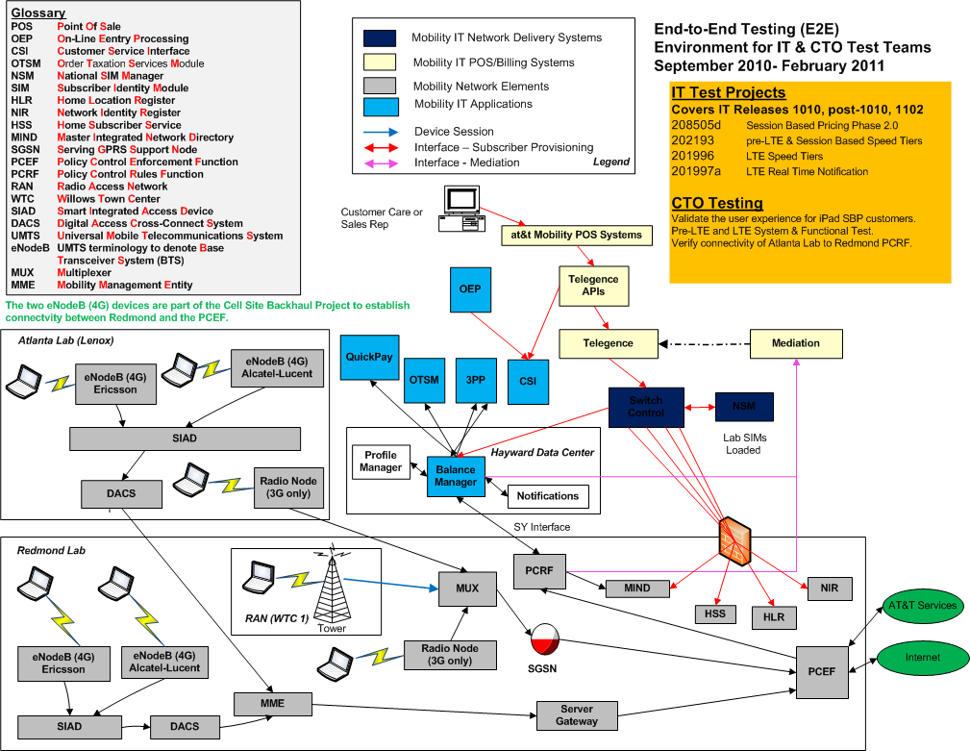
Environment for IT & CTO Test Teams

Slide 16
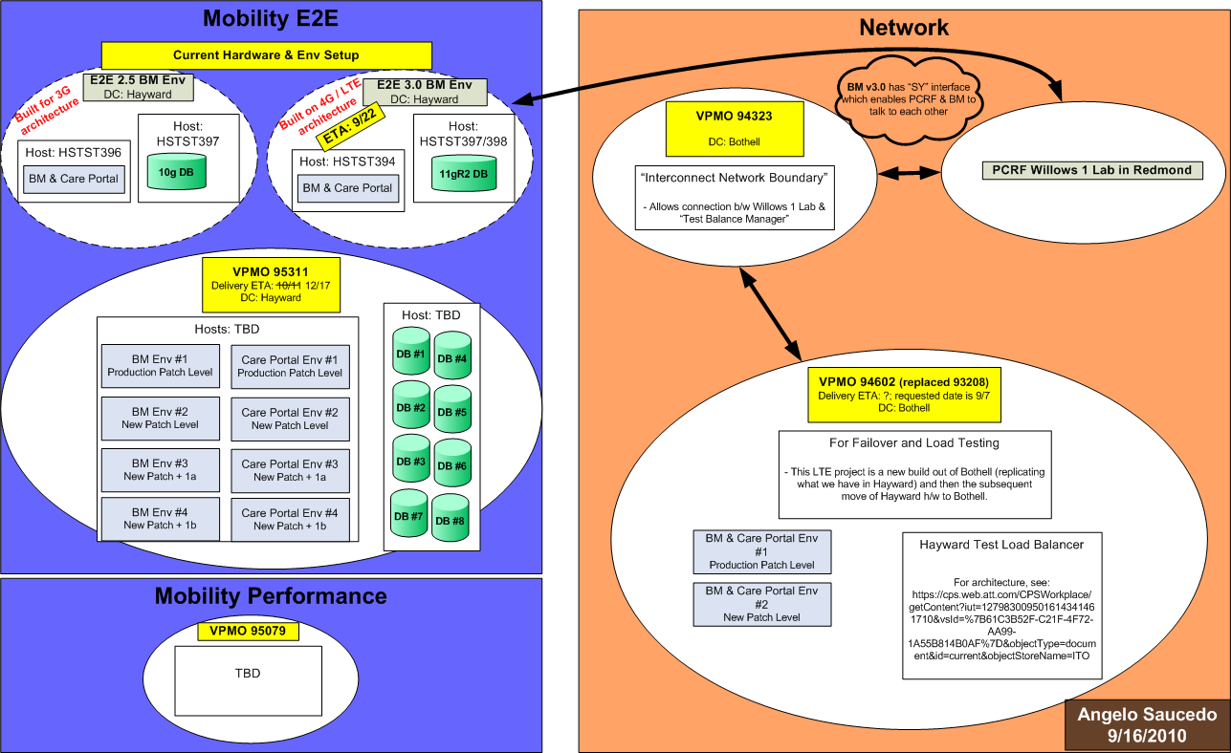
BM QA Environment Setup

